Slide 1



NVDLA SDP Architecture
Cong Liu
16/11/2007

Slide 2
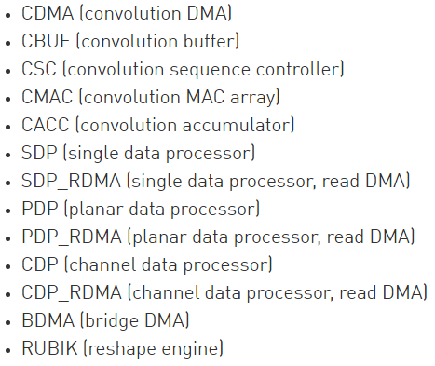
Pipeline Stage

Slide 3
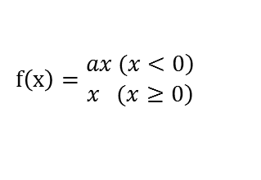
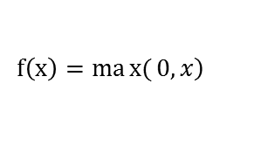



Function
{
Liner
functions onto individual data points (activation)
Non-linear
dedicated hardware logic
dedicated Look-Up-Table
Batch normalize
$$f\left(x\right)= \frac{x−E}{Var} ×scale+bias$$
ReLU
Sigmoid
$$\left.f\left(x\right)=max{(}0,x\right)$$
$$sigmoid\left(x\right)= \frac{1}{1+e^{−x}}$$
PReLU (a是个很小的函数)
Tanh
$$f\left(x\right)=\begin{matrix}\left.ax (x<0\right) \\ \left.x (x≥0\right)\end{matrix}$$
$$\tanh\left(x\right)=2sigmoid\left(2x\right)−1$$

Slide 4
Function
Precision Scaling ?
Scale Factor
Bias Addition
Element-Wise Operation (add sub multiply max)
{
per-layer : register
per-channel : memory interface
Scale factor
per-layer : register
per-channel : memory interface
per-feature : memory interface
bias
{

Slide 5
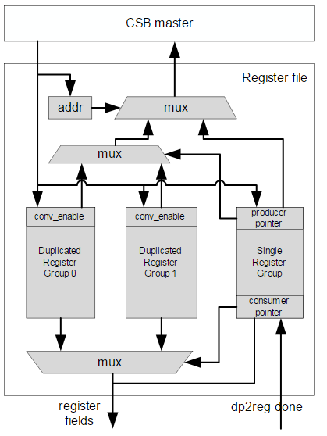
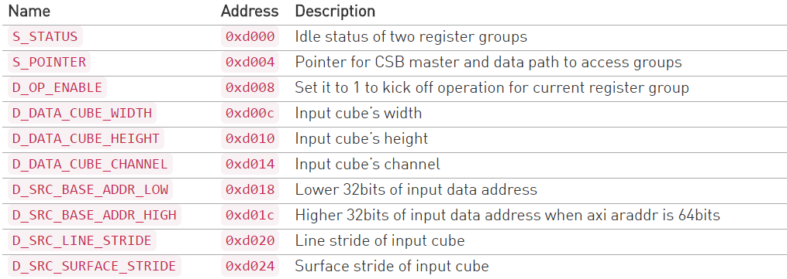
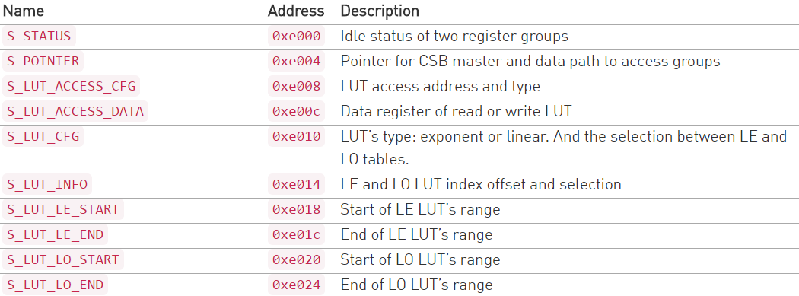
Configure Register
ping-pang register file
……
……

Slide 6
Architecture

Slide 7
Next Work
Data format
Implementation of functions
Detailed Timing

Slide 8
Thank you !
Discussion

